Slide 1
Static Members, Static Class, Friend Function, and Friend Class
Conducted by
Mehedi Hasan
Lecturer, Dept. of CSE

Slide 2
1. Static Class Members
Shared across all objects of a class
Memory allocated only once for the class
Accessed using ClassName::member
Useful for common properties (e.g., interest rate, counters)
Real-life Example: Bank interest rate is same for all accounts.

Slide 3
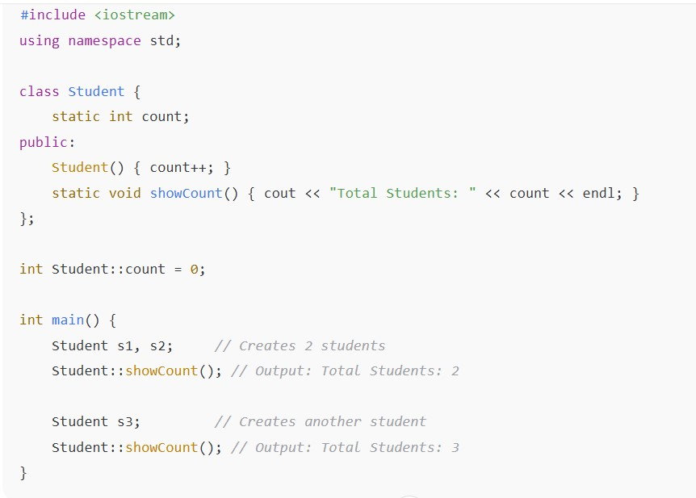
Static Member : Counting Objects

Slide 4
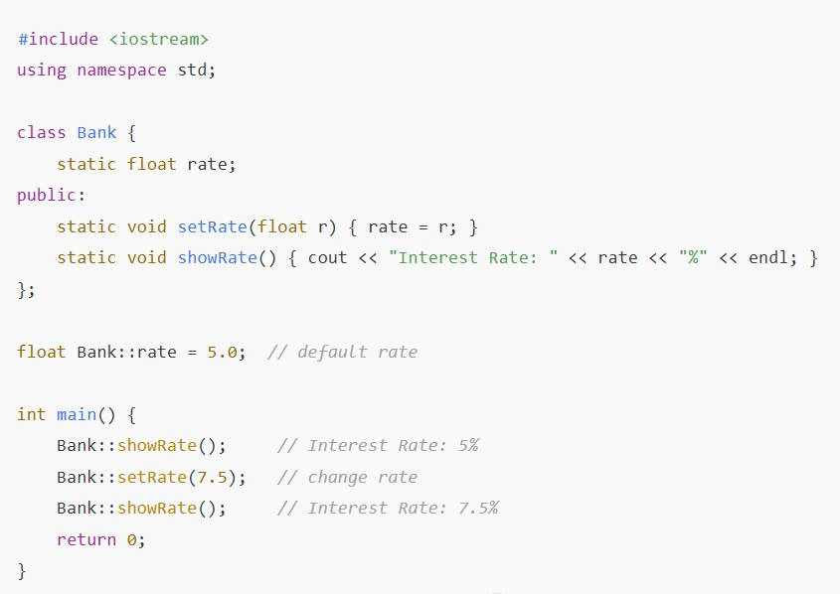
Static Member :Bank Interest Rate

Slide 5
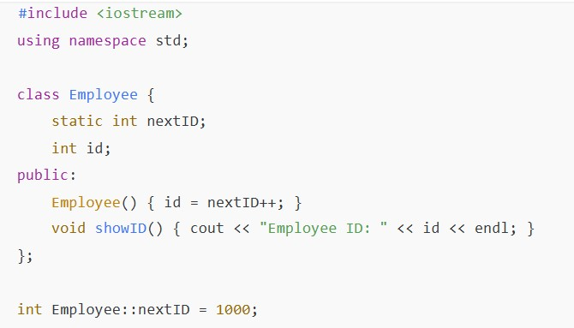
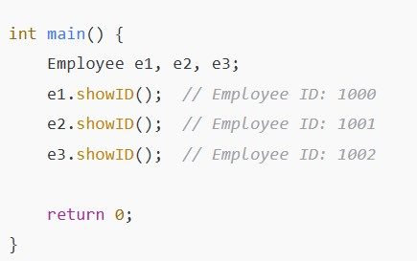
Example (Difficult): Unique Employee ID

Slide 6
2. Static Class (Simulated)
C++ does not have static class like C#
We simulate by making all methods static
Useful for math libraries, helper functions
Example: MathUtility::square(5)

Slide 7
3. Friend Function
Not a member, but can access private data
Declared inside class with keyword 'friend'
Often used in operator overloading
Real-life Example: Allowing a special function to access ATM account balance.

Slide 8
Friend Function :Access Private Member
#include <iostream>
using namespace std;
class base {
private:
int private_variable;
protected:
int protected_variable;
public:
base() {
private_variable = 10;
protected_variable = 99;
}
// Friend function declaration
friend void friendFunction(base& obj);
};
// friend function definition
void friendFunction(base& obj) {
cout << "Private Variable: "
<< obj.private_variable << endl;
cout << "Protected Variable: "
<< obj.protected_variable;
}
int main() {
base object1;
friendFunction(object1);
return 0;
}

Slide 9
Friend Function :Access Private Member with static member
class base {
private:
static int static_var;
public:
friend void friendFunction();
};
int base::static_var = 42;
void friendFunction() {
cout << "Static Variable: " << base::static_var;
}
int main() {
friendFunction(); // works without passing an object
return 0;
}
N.B:
If a class has a static member, it belongs to the class itself, not to an object.

Slide 10
Friend Function
Non-static members → Need an object to access,
even in a friend function.
Static members → Can be accessed directly by the friend
function without an object.

Slide 11
4. Friend Class
A class can grant another class access to its private data
Declared using: friend class ClassName;
Useful in strong relationships (e.g., Car ↔ Engine)
Real-life Example: A Bank Manager has full access to a Customer Account.

Slide 12
Example: Car and Engine
// Car class
class Car {
private:
Engine engine;
public:
Car(int hp) : engine(hp) {}
void showHorsepower() {
// Accessing private member of Engine
cout << "Car engine horsepower: " << engine.horsepower << endl;
}
};
#include <iostream>
using namespace std;
// Engine class
class Engine {
private:
int horsepower;
public:
Engine(int hp) : horsepower(hp) {}
// Declare Car as a friend class
friend class Car;
};
int main() {
Car myCar(250); myCar.showHorsepower();
return 0;
}

Slide 13
Summary
• Static Member: Shared property (Bank interest)
• Static Function: Operates only on static data
• Static Class: Utility library (Math functions)
• Friend Function: Special function access (ATM)
• Friend Class: Strong relationship (Bank Manager ↔ Account)

